Slide 1

Detection of Hateful and Offensive Tweets using Deep Learning
Group Members:
M. Kovida - AP22111260002
P. Hema Lalitha - AP22111260025
T. Deepak Kumar - AP22111260031
Dr Vivek Yelleti
Assistant Professor
Department of Computer Science and Engineering

Slide 2
Introduction
What is hate speech?
Speech that attacks individuals or groups based on attributes such as race, religion, ethnic origin, national origin, sex, disability, sexual orientation, or gender identity.
Why detecting hate speech on Twitter is important?
Twitter is one of the largest social media platforms with millions of daily tweets. Detecting hate speech helps maintain healthy online discourse and protects vulnerable communities.
Multilingual Indian Context
India has 22 official languages. Users often code-mix (e.g., Hinglish), making automated detection challenging but crucial for a diverse digital ecosystem.

Slide 3
Problem Statement
Core Need
Development of an automated multilingual hate speech detection system capable of handling the linguistic diversity of Indian social media users on Twitter.
Key Challenges
Slang and informal language variations
Code-mixing (e.g., Hindi + English = Hinglish)
Abusive language variations and euphemisms
Contextual sarcasm and implicit hate
Lack of annotated multilingual datasets

Slide 4
Motivation
Rising Online Toxicity
Significant increase in hate speech and online harassment across social media platforms, particularly during sensitive events.
Multilingual Communication
Indian users communicate in Hindi, English, Telugu, and other regional languages, often mixing multiple languages in single posts.
Detection Gap
Existing systems primarily focus on English content, leaving a significant gap in detecting hate speech in Indian languages.
↑ 150% increase in reported incidents
22+ official languages in India
85% systems are English-only

Slide 5
Novelty
Multilingual Dataset
English (~12k tweets)
Comprehensive Comparison
Machine Learning models
XAI Integration
LIME explanations
Hindi (combined from 3 sources)
Telugu tweets
Deep Learning models
Transformer models
SHAP values
Integrated Gradients

Slide 6
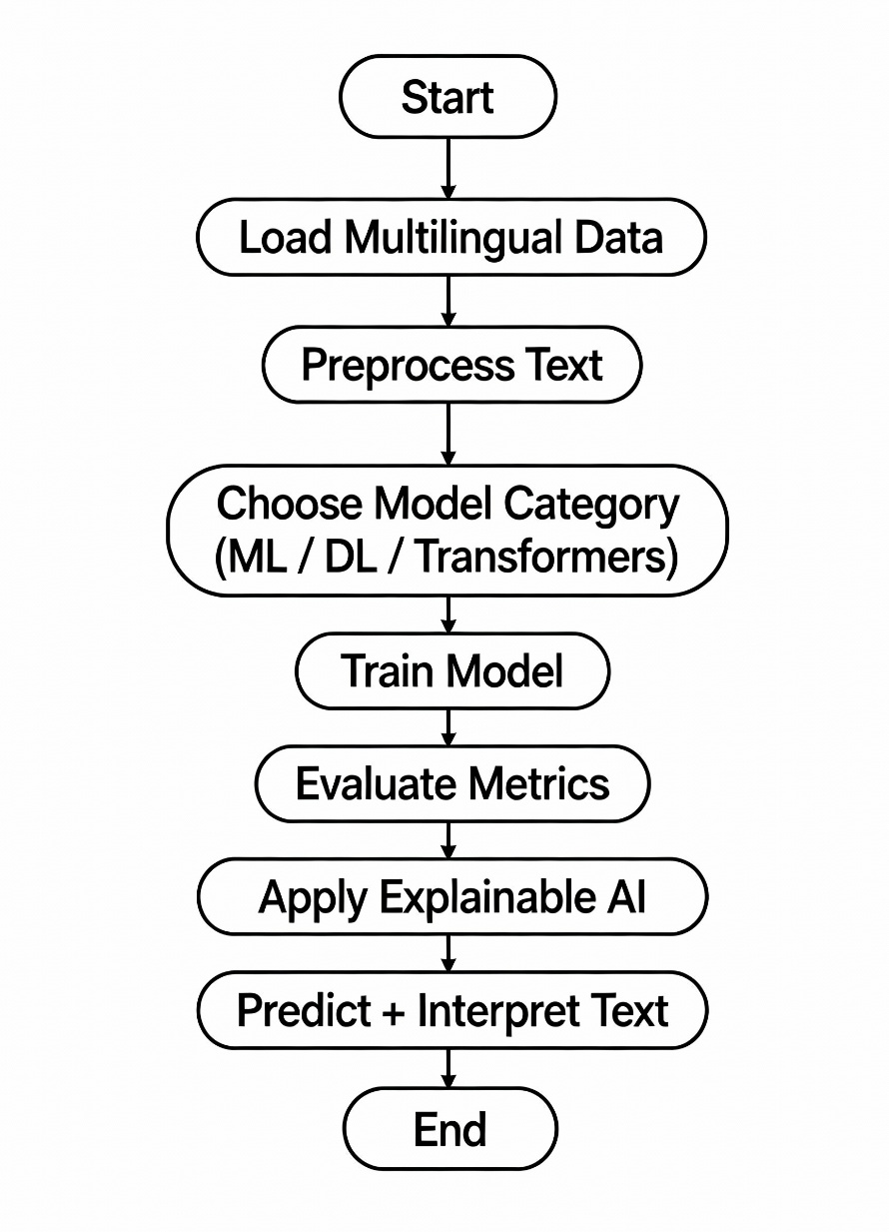
Flowchart

Slide 7
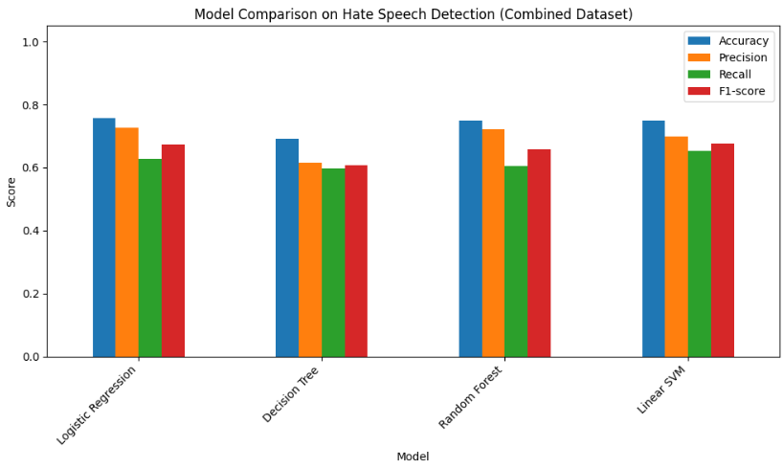
ML Models and Results
Used ML models as a baseline for text classification.
Selected four common models: Logistic Regression, Decision Tree, Random Forest, Linear SVM.
These models work well with TF-IDF features and high-dimensional text data.
Logistic Regression performed the best in terms of accuracy and F1-score.

Slide 8
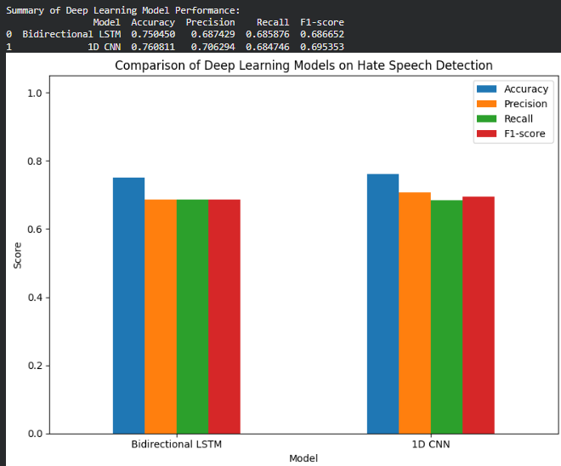
DL Models and Results
Used two Deep Learning models: BiLSTM and CNN to learn sequence patterns.
Both models showed only a small improvement over traditional ML methods.
Mixed-language tweets and informal text reduced their effectiveness.
Overall, Deep Learning models did not achieve major performance gains on this dataset.

Slide 9
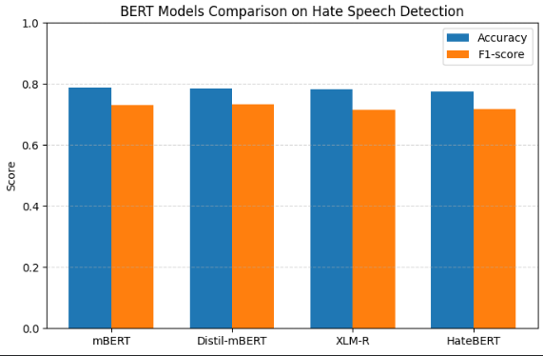
Transforms Models and Results
Transformer models performed the best among all approaches.
mBERT achieved the highest accuracy on the multilingual dataset.
XLM-RoBERTa gave the best F1-score, showing strong balanced performance.
HateBERT underperformed because it was mainly trained on English abusive data, not multilingual or code-mixed text.

Slide 10
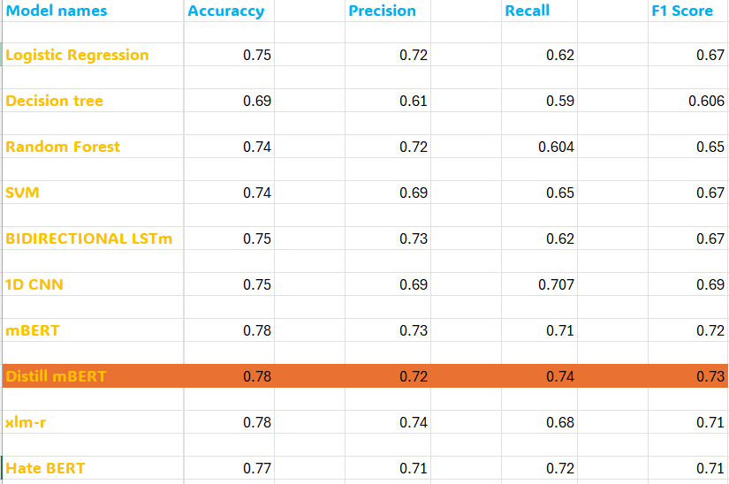
Results

Slide 11
Explainable AI
Used three XAI methods: LIME, SHAP, and Integrated Gradients to analyze model behavior.
These tools show which words had the strongest influence on predictions.
XAI helps ensure the model’s decisions are transparent and trustworthy.
Important for hate speech tasks where wrong predictions can have real-world impact.
XAI revealed that models correctly highlighted harmful or abusive expressions.
These insights helped validate that the Transformer models were making meaningful and fair decisions.

Slide 12
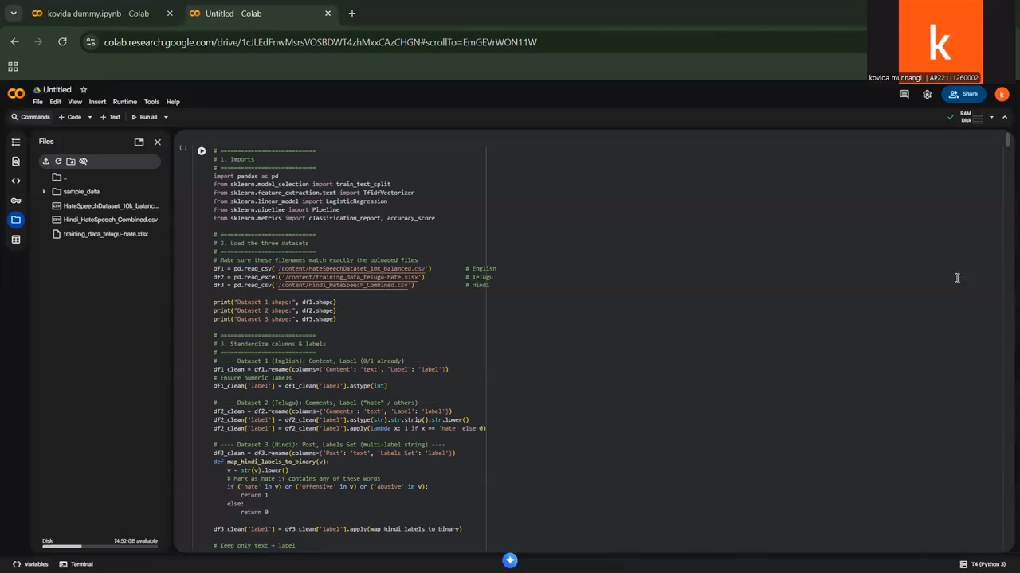
Implementation

Slide 13
Testing

Slide 14
Future Work
Expansion to More Languages
The model can be extended to additional Indian languages like Tamil, Bengali, and Kannada to improve multilingual coverage.
Larger and Diverse Dataset
A bigger and more varied dataset can help the model generalize better across different writing styles and contexts.
Multimodal Hate Detection
Real-Time Deployment
Future systems can combine text with images and memes to identify hate speech in multimedia content.
The model can be optimized for real-time monitoring and automatic moderation on social media platforms.

Slide 15
Conclusion
Transformer models achieved the best performance, with mBERT and XLM-RoBERTa leading the results.
The multilingual dataset improved the system’s ability to detect hate speech across English, Hindi, and Telugu text.
Machine Learning and Deep Learning models provided useful baselines but struggled with complex, code-mixed tweets.
Explainable AI helped interpret model decisions, making the system more transparent and trustworthy.

Slide 16
Thank you

